Slide 1

MUKONO HEALTHCARE CENTER
Group 12: Alli Hanlon, Mikail Abu Mohammed, Mike Laird, Shangjing Tang, Yue Zou and Jimena Rodriguez

Slide 2



USER-FRIENDLY
Simple and Dynamic User Experience
Clear Instructions
Notes:
Simple and Dynamic User Experience
The dashboard and visual aids help the user identify different tabs and functions of the website at first glance.
Clear Instructions
Tables and forms are clearly labelled, making it easy for the user to interact with them.

Slide 3
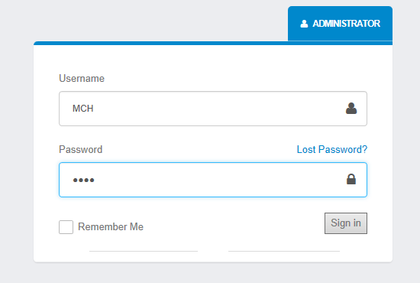
SECURITY
Ensures Privacy and Security of Information
Place your screenshot here
Unique Username and Password
Clearance Level Administration
Notes:
Unique Username and Password
Each stakeholder will has a unique username and password to log into the portal.
Clearance Level Administration
This password will redirect the stakeholder to their dashboard according to the clearance level. Administration has access to all levels.

Slide 4
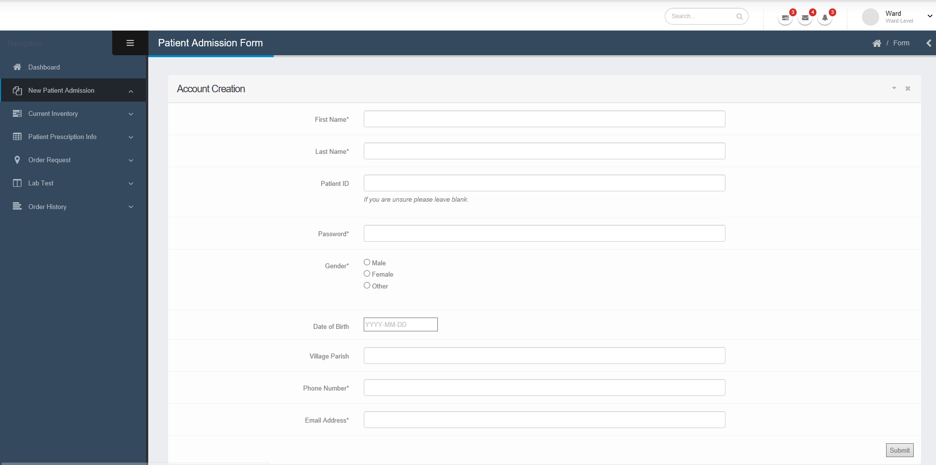
ELECTRONIC FORMS
Purchasing Orders
Prescription Records
Patient Records
Notes:
Patient Records
Electronic database of patient records and history, with an easy New Patient Admission Form.
Purchasing Orders
Automatically order medicine and tools from the wards to the main store, and from the main store to the government.

Slide 5
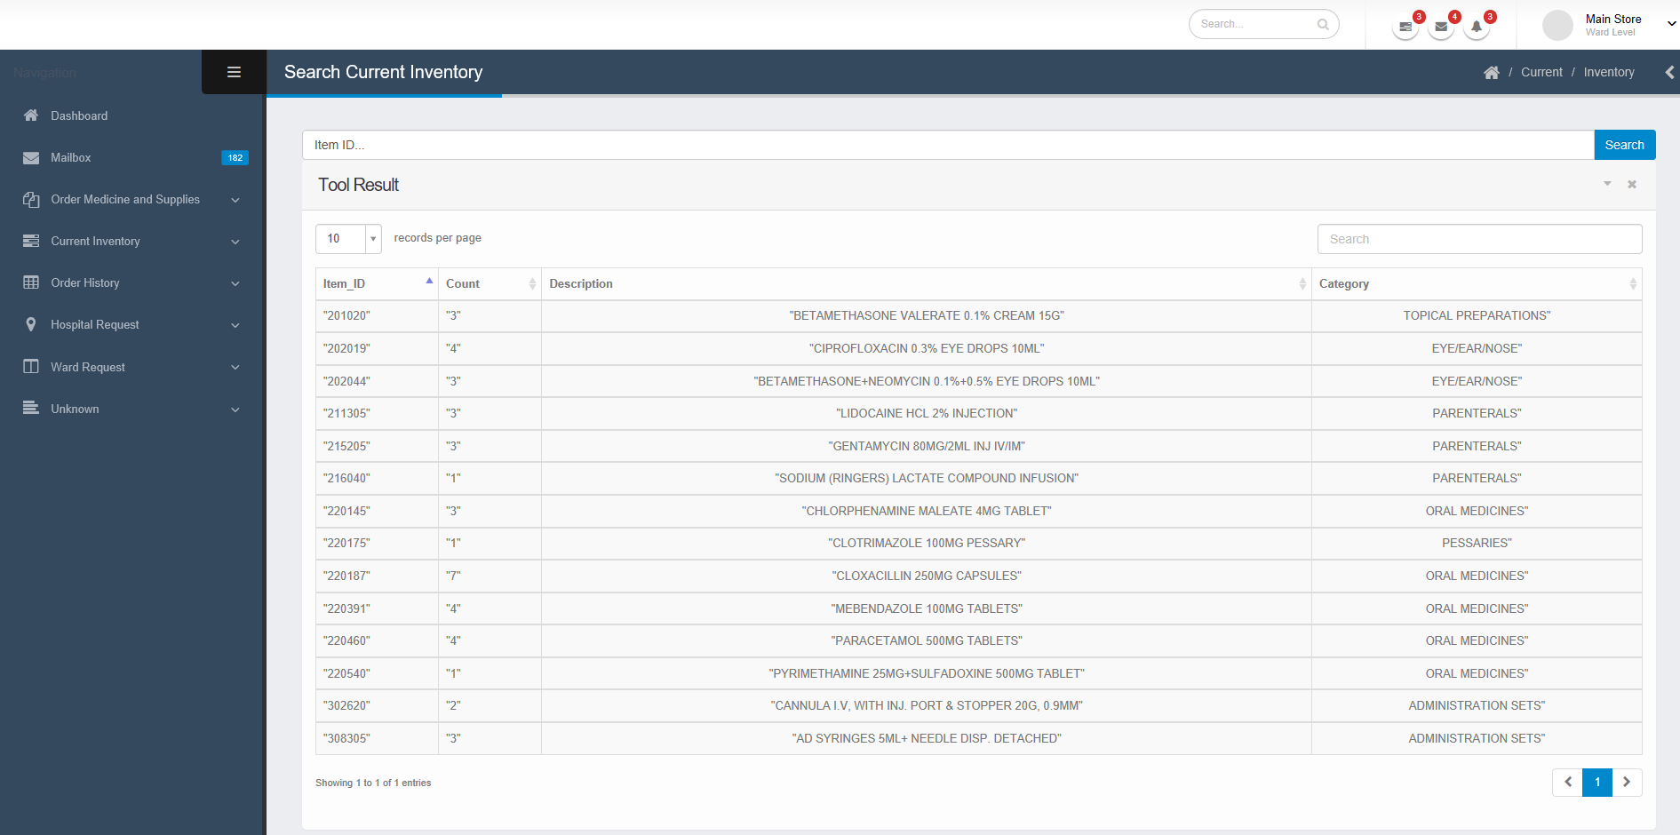
ORDER AND INVENTORY CONTROL
Past Order and History
Real-Time Inventory
Notes:
Real-Time Inventory
Wards and the Main Store can access their current inventory in real-time, to check quantity and expiration date of each item.
Past Order and Inventory Records
It will record past orders, expired, and used inventory made at every level.
Order Accuracy Check
It will compare the delivered order to the expected order to ensure there aren’t any discrepancies.

Slide 6
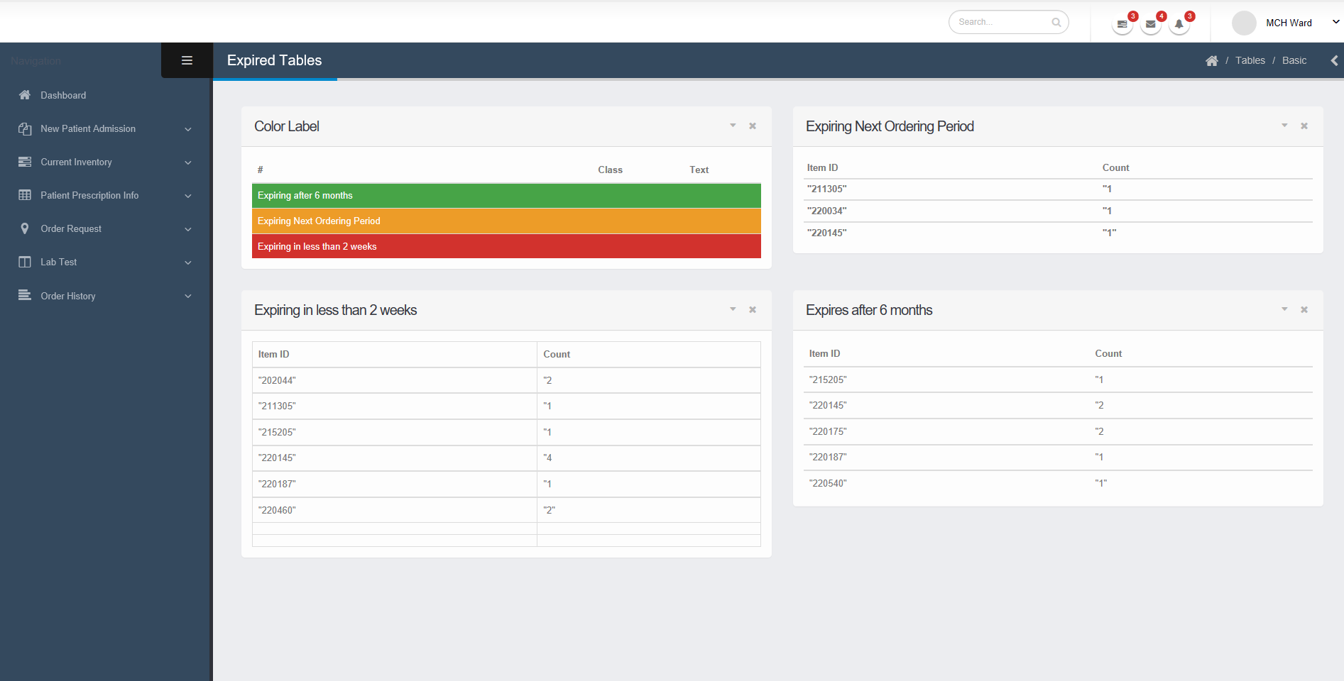
ORDER AND INVENTORY CONTROL
Expired Inventory
Order Accuracy Check
Notes:
Real-Time Inventory
Wards and the Main Store can access their current inventory in real-time, to check quantity and expiration date of each item.
Past Order and Inventory Records
It will record past orders, expired, and used inventory made at every level.
Order Accuracy Check
It will compare the delivered order to the expected order to ensure there aren’t any discrepancies.

Slide 7
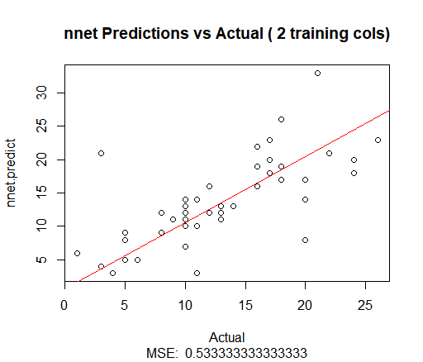
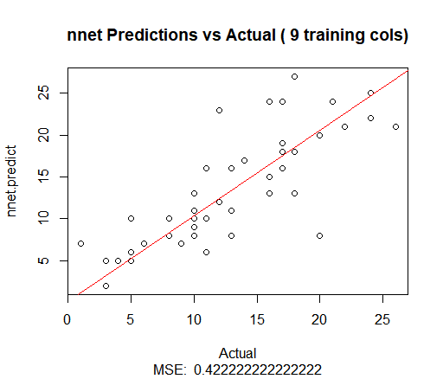
PREDICTION TOOL
Notes:
Order Necessary Quantities of Medicines
Outputs a predicted “need” of each item based on past order and use history
Improves prediction as more ordering data is collected
Reduce Inventory Waste
Have in stock only the necessary medicines per period. Reducing wasted inventory space.

Slide 8
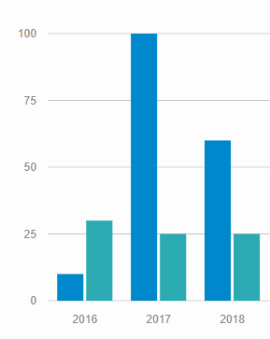
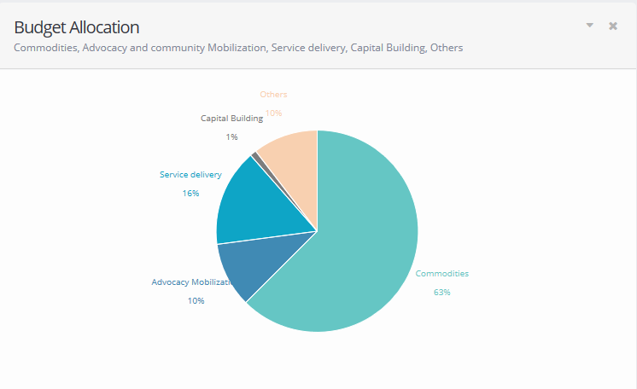
SMART BUDGET
Notes:
Visual Controls
The visual representations of the budget lets you easily see how the budget is being allocated.
Main Store and Administration Levels
Main Store and Administration will have access to the budget

Slide 9
ADAPTABLE

Slide 10





SQL INJECTION INC.
THE ONLY INJECTION YOU’LL EVER NEED!
FOLLOW US ON YOUR FAVORITE NETWORK
FB.COM/SQLiINC
@SQLiINC
@SQLi_INC
SQLiINC

